Slide 1
Invoice Matching Application
- Suresh CHINNA SHANMUGAM

Slide 2
Agenda
Project Flow – SDLC Life Cycle => Requirements to deployment & Conclusion.
Functional Flow - Load Input Data-> Invoice Processing -> Matching/Unmatching -> Output Rendering using Python API
Introduction
Implementation
Results
Future
Work
Requirement Analysis
Data Sources
Design Approach
Lesson’s Learned
Conclusion
Notes:
Project’s Agenda is as follows:
In the introduction, the motivation factors for choosing this subject will be discussed. Then thesis context and problem statement are accompanied by contributions to this research are described.
In the related study provides a summary of Invoice Matching Application flow.
Next Data Sources section, Information regarding the input data sources that were used in this project analysis can be found.
In Design approach, The architectural design and data pipeline are defined.
In the implementation section, the input data used, algorithms or project implementation are described. In addition to preprocessed data preparation, later how the model sent to corresponding methods to get the desired functional outcomes.
In the result section, based on the input data source, we can see the implementation of matching and unmatched invoice and payment processing association using Lettering and recovery used to achieve the desired results..
The assessment section discusses the validation of results performed to meet the functional requirements.
After that, conclusion of this project – Future work & Enhancement scope.
Finally in the future scope, this project base has potential to enhance further to meet all the future requirements.

Slide 3
Introduction
Invoice Processing
Motivation
The key focus area is to implementation of Invoice Matching(Processing) Application using Python
Context
The Process logic, Design Approach, Implementation and test execution, deployment and results validation are key activities to meet the functional requirements.
Problem Statement
Required to find the list of Invoices/payments and that are matched or Balanced between Debit and Credit amounts, and list the remaining Unmatched records.
Contribution
Implementation of business process logic using python, database and Flask API

Slide 4
Requirement Analysis
Requirement Analysis
High level Requirements – To create Matched Invoices with the payment (Types) data based on Debit and credit amounts – The Balanced amounts.
Technological Specification: Pure Python, API Mode, One backend Table – Hence Opted for MySQL DB to store the required data into Database.
Meta Data/ Schema for the tables
The Key Requirements from User(Operado)
Create an instance to feed the table. The video does not show the addition of Invoice, but it will be necessary to envisage it for the continuation
Filter results based on instance data
The possibility of associating instances of payment and invoice type when the amount is matching
ex : Invoice in the amount of € 20 and a payment of € 2
Assumptions:
NO Specific Data format given, Hence Created CSV file format as input from the Jpeg Sample Data provided by Operado for the current project implementation.
No Technological Specification to use on Python API – Hence Opted for Python Flask to display the output data in the HTML page from the processed Json Files for all the matched and Invoices invoices
No Specific requirement on Unmatched records, hence added additional Enhancements
Additional Enhancements:
– Additional Implementation to display All Unmatched Invoices order by Recover (Due, Not Due and Blank)
- Implementation on to display the summary of Unmatched records based on Recovery (Debit and Credit Summary)

Slide 5
Data Source – Input and Output
Data Source – From the Jpeg Image provided by Oparedo used as Input to Create CSV file format and created output matched and unmatched data into Json Files and loaded in HTML page using Python Flask API methods.
Processed Output Data, (Matched, Unmatched)
CSV File – Input Data
Loaded into MySQL DB - IINVOICETAB
56 Samples
Converted to Data Frame
Loaded to Html using Python Flask API (Front End)

Slide 6
Design Approach

Slide 7
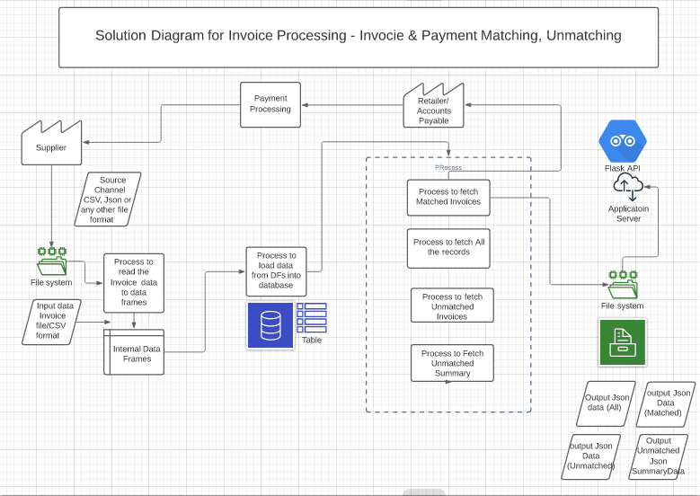
Solution Architecture Diagram – High level

Slide 8
Implementation

Slide 9
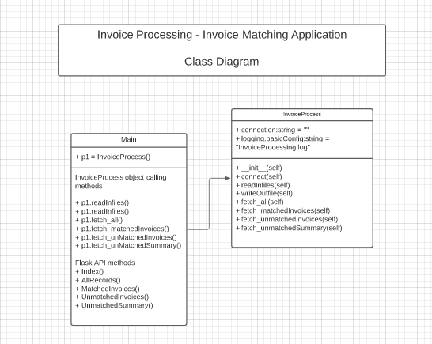
Implementation – Low Level Design
Git Hub Link - https://github.com/sureshcs0524/PythonProjects
2 python scripts – main.py, InvoiceProcess.py
Packages used:
pandas, pymysql, numpy, shutil, os, json, logging, Flask, jsonify, render_template, request, redirect
Database: mysql
Database Name: InvoiceDB
Table name: INVOICETAB
1 Key class – InvoiceProcess with the methods. List of members and methods
templates folder used for flask API to load json data into Html page
content.html – Home Page
Index.html – Index Page
AllRecords.html
MatchedInvoicesPayment.html
UnmatchedInvoices.Payment.html
UnmatchedSummary.html

Slide 10
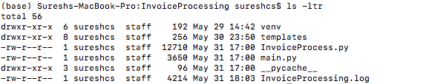
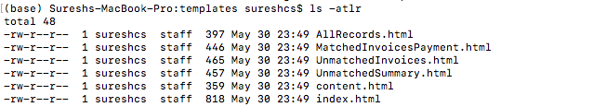
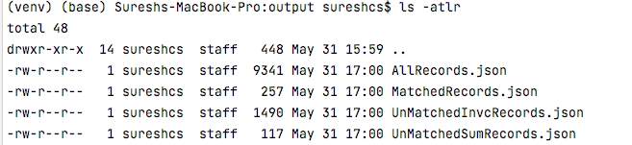
Code & Data Paths – Input/output
Project Path:
~/PycharmProjects/InvoiceProcessing
Files: main.py
InvoiceProcess.py
Templates:
Html Files listed in previous page
Log File:
InvoiceProcessing.log
Input:
~/PycharmProjects/input
File: CSV File: InvoiceTestData.csv
Output:
Path: ~/PycharmProjects/output
Temp Files: Json Files:
AllRecords.json
MatchedRecords.json
UnMatchedInvcRecords.json
UnMatchedSumRecords.json

Slide 11
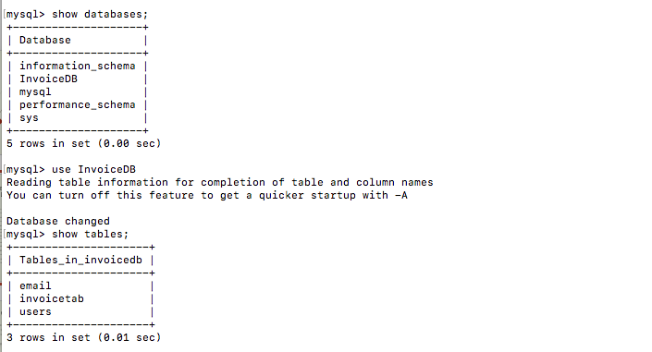
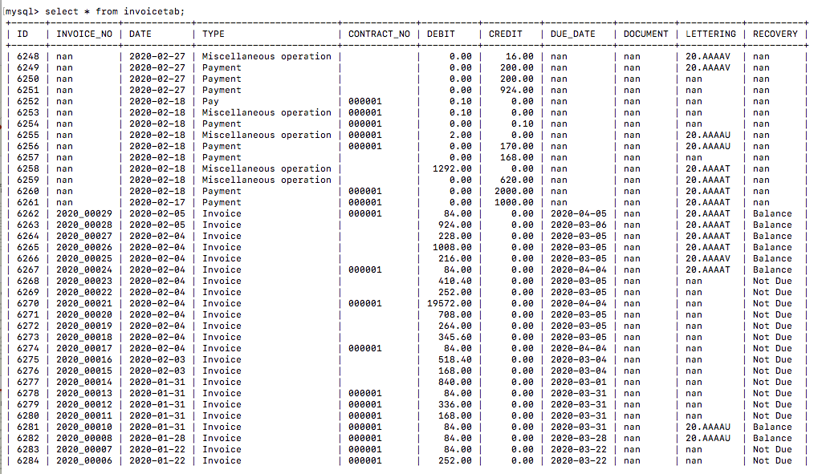
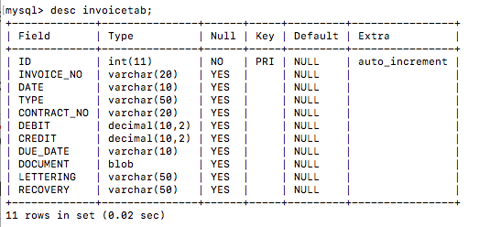
Database
Database Details
Database: MySQL DB
Python package: pymysql
Database name: InvoiceDB
Table name: INVOICETAB
Data Schema
Shown in the screen shot

Slide 12
Results

Slide 13
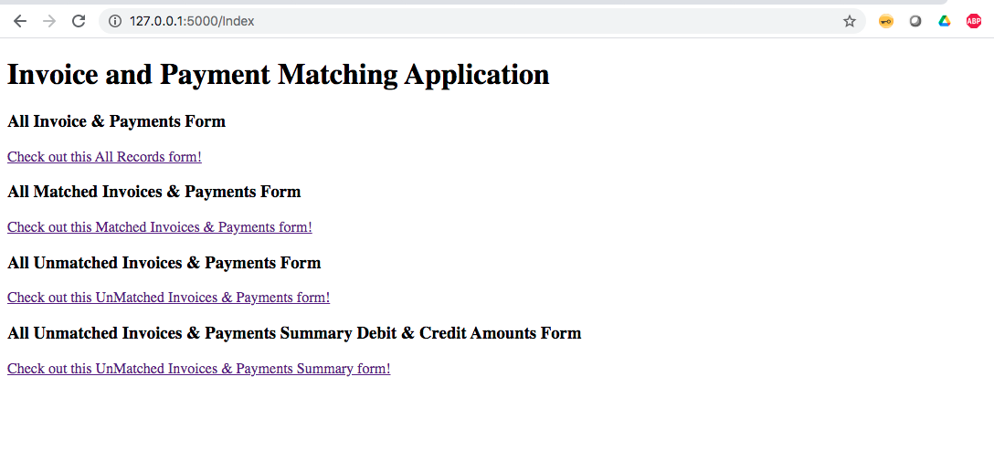
Index Page – using python API
Results Displayed in Front End – Index Page for Invoice and Payment Matching Application: Rendered using Python Flask API - with POST, GET methods.
URL:
Index Page: http://127.0.0.1:5000/Index
Index Page Includes List of Operations
All Invoices and Payment Form
All Matched Invoices & Payments Form
All Unmatched Invoices or Payments Form
All Unmatched Invoices & Payments Summary – Debit & Credit Amounts Form

Slide 14
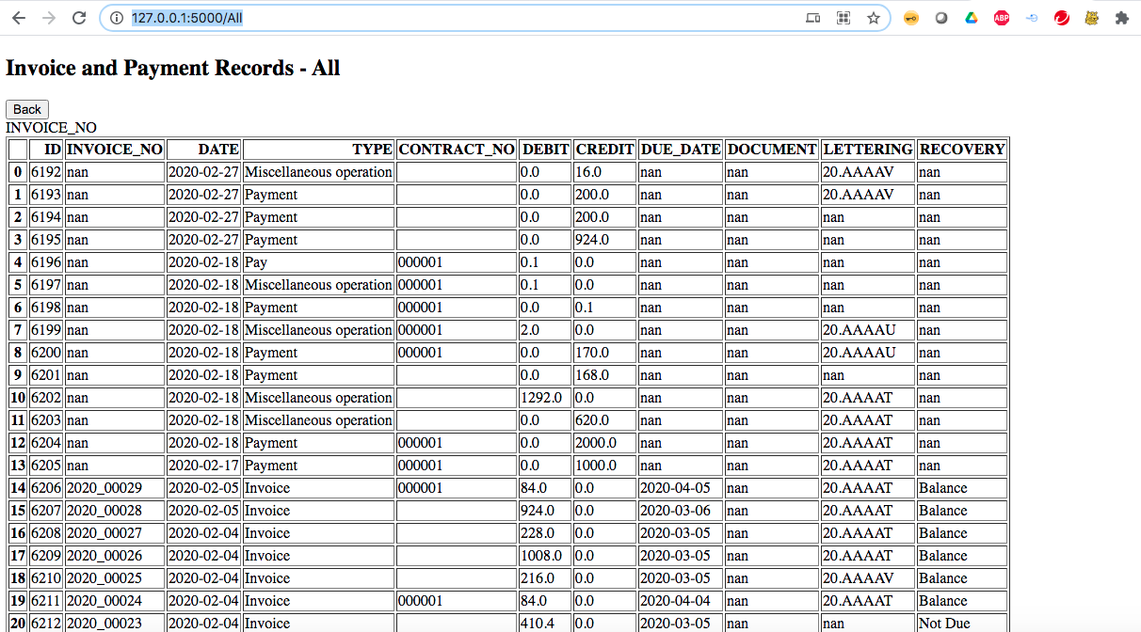
All Records Page - using python API
All Records Page – List of all the data records loaded to database from the Input CSV data – Rendered using Python Flask API - with POST, GET methods.
URL: All records Page:
http://127.0.0.1:5000/All
All Records - List of Operations
List of All the records from the database table – INVOICETAB
The data pulled from INVOICETAB, converted to Data frame -> Json file -> then rendered the json file to html

Slide 15
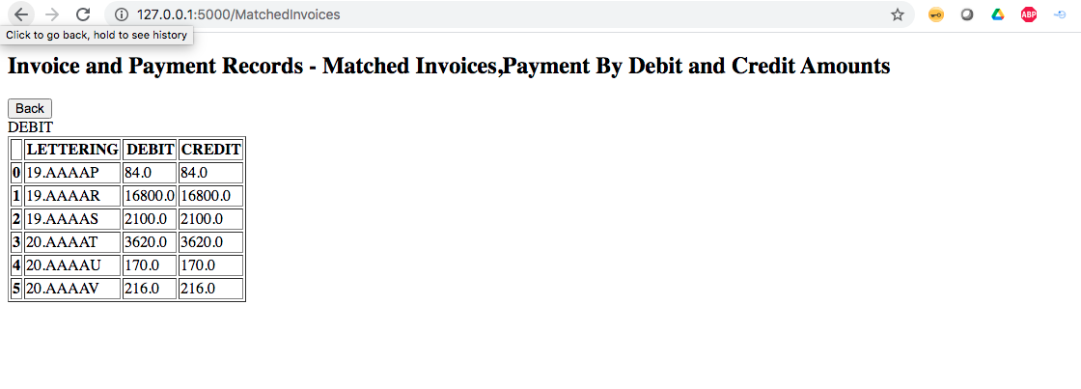
Matched Invoices Page - using python API
Matched Invoices Page – List of all the Matched Invoices associated based on LETTERING Ids– Rendered using Python Flask API - with POST, GET methods to display in html page.
URL: Matched Invoices Page:
http://127.0.0.1:5000/MatchedInvoices
Matched Invoices - List of Operations
List of All matched Invoices and Payments by Debit and Credit Amounts associated by LETTERING IDs processed from the data retrieved from the database table – INVOICETAB
The matched Invoice data pulled from INVOICETAB, converted to Data frame -> Json file -> then rendered the json file to html

Slide 16
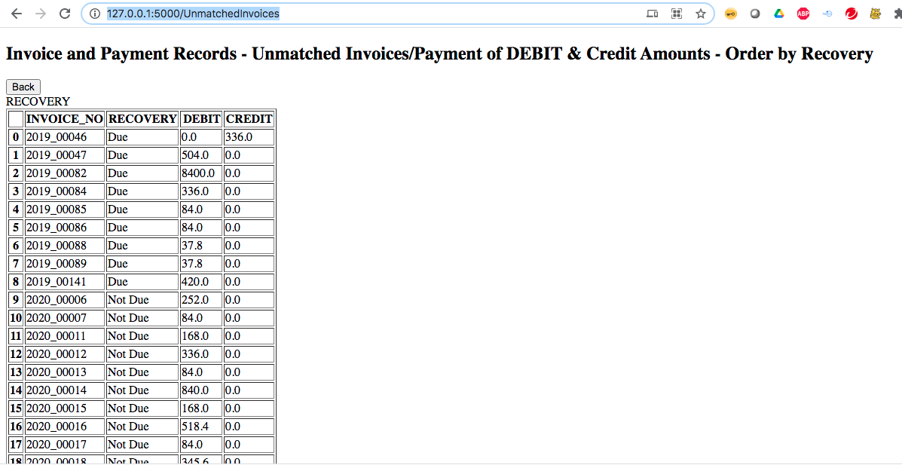
Unmatched Invoices Page – using python API
Unmatched Invoices Page – List of all the Unmatched Invoices order by RECOVERY – Rendered using Python Flask API - with POST, GET methods to display in html page.
URL: Unmatched Invoices Page:
http://127.0.0.1:5000/UnmatchedInvoices
Unmatched Invoices- List of Operations
List of All Unmatched Invoices and Payments by Debit and Credit Amounts group by Invoice_no order by recovery (Due – Echu , Not Due – Non échu, none/blank), for the data retrieved from the database table – INVOICETAB
The data pulled from INVOICETAB, processed using unmatched invoices business logic, converted to Data frame -> Json file -> then rendered the json file to html

Slide 17
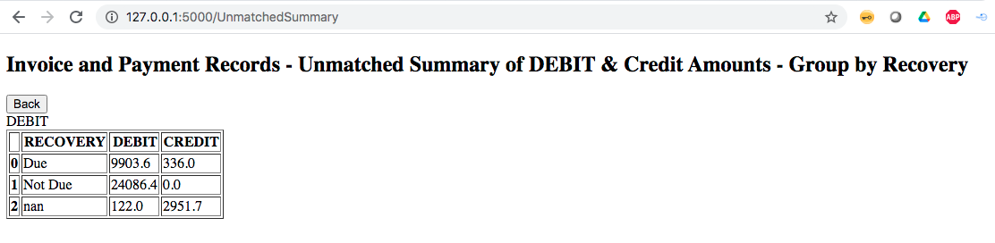
Unmatched Summary – using python API
Unmatched summary Page – List of all the Unmatched summary of records group by RECOVERY – Rendered using Python Flask API - with POST, GET methods to display in html page.
URL: Unmatched Invoices Page:
http://127.0.0.1:5000/UnmatchedSummary
Unmatched Summary - List of Operations
List of All Unmatched summary of Debit and Credit Amounts group by by recovery (Due – Echu , Not Due – Non échu, none/blank) for the data retrieved from the database table – INVOICETAB
The data pulled from INVOICETAB, processed using unmatched summary business logic, converted to Data frame -> Json file -> then rendered the json file to html

Slide 18
Lesson’s Learned
Requirement Analysis
Clearly addressed requirement gaps. – In/out of scope.
Additional enhancement requirement questions – Data Security, User authentications, Functionality etc
Development Best practices
Enhanced Standard Implementation practices with the efficient usage of python packages.
Thorough research and study with the usage of efficient process logic in the implementation to transfer the json data directly into python flask API to get and post the messages to the front-end app.
Deployment of code in the application server or cloud.
Future Enhancements work:
Understand any Business process enhancement requirements from the users.

Slide 19
Future Scope
Within Scope
Matched Invoices
Invoice: Debit type transaction Payment: Credit type transaction Transaction association (lettering) is only done between balanced credit and debit type transactions Example: Ex:
1 invoice of 10€ and 1 payment of 10€.
2 invoices of 10€ and 1 payment of 20€.
2 invoices of 10€ and 2 payments of 10€.
1 invoice of 10€ and 2 payments of 5€ each
Out of Scope:
No 30way matching between Order, Invoice, and Payments - Requirement to match only between DEBIT and credit amounts.
No Invoice detail(line) level matching (SKUs, Quantities etc)
Additional Enhancements Included:
Unmatched Invoices/payments of Debit & Credit Amounts – Order by Recovery ((Due. - Echu, Not Due – Non-échu, Blank)
Unmatched Summary of DEBIT & Credit Amounts – Group by Recovery. (Due. - Echu, Not Due – Non-échu, Blank)
Further Enhancements Scope:
This project can be enhanced for future requirements
This can be enhanced for future requirements like - 3 or 4-Way Matching - If additional details are provided ( Order Information, Shipment, Invoice and Payments)
Matched and Unmatched Detail level Matching ( SKUs, and Quantities)
Multiple Format Input files & sources
Data Security/User authentication requirements
Payment processing – Accounts Payable process etc

Slide 20
Thank you
- Suresh CHINNA SHANMUGAM
- Email: suresh.cs0524@gmail.com
- Mobile: +33 758072207

